Slide 1
Modeling water pipes faults in KPI Campus
Dmytro Bubela KM-82 FAM

Slide 2
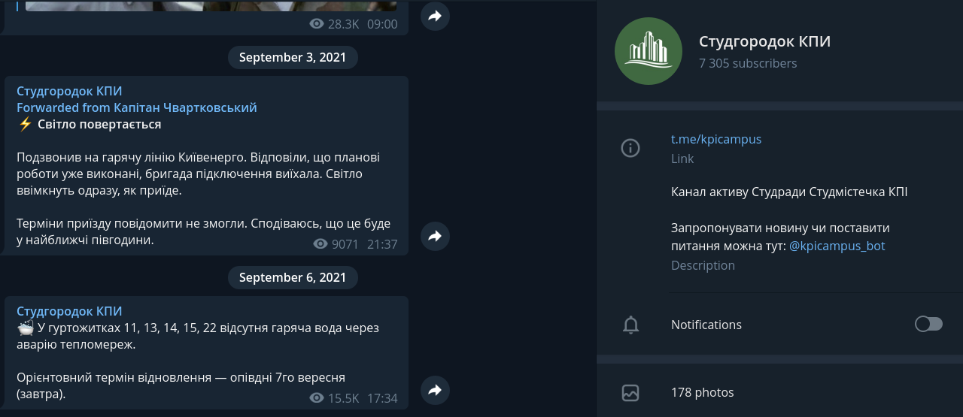
Preparation

Slide 3
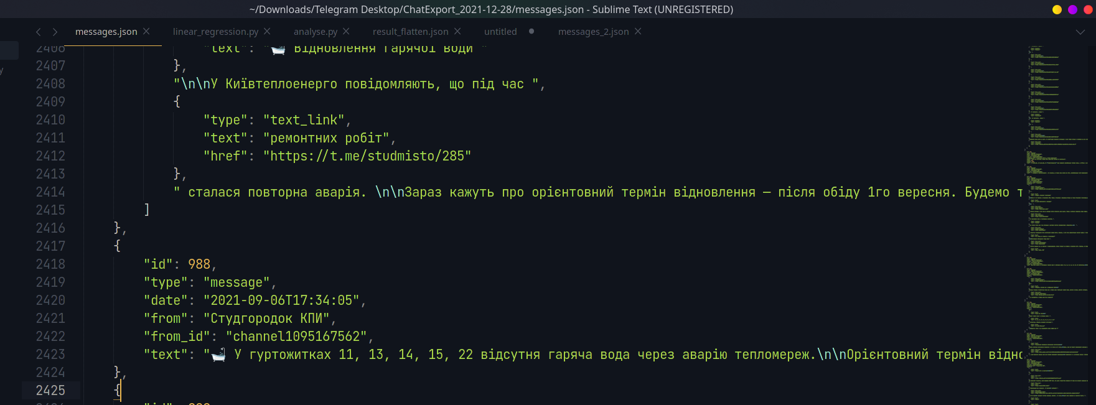

Slide 4
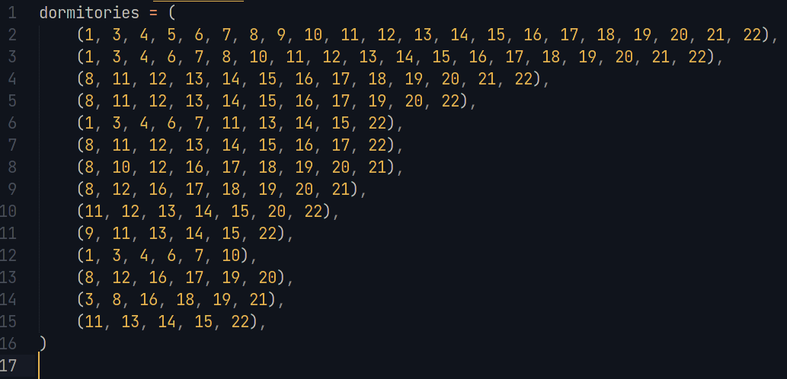

Slide 5
